Slide 1
Lexis diagram and system of demographic indicators
16. 11. 2022, 23. 11. 2022
Bety Ukolova – ukolovae@natur.cuni.cz

Slide 2
Lexis diagram: exercise
a. Deaths at completed age 2 years, from birth cohort 1989
b. Deaths at reached age 2 years from birth cohort 1989
c. Death at completed age 2 years in 1991.
d. Deaths at completed age 11 years during 2002–2003
e. Deaths at reached age 11 years during 2002 and 2003
f. Deaths at completed age 2 years in 1991 from birth cohort 1989
g. Deaths at completed age 11 and 12 years in 2002–2003
h. Persons living at exact age 36 in years 2002–2003
i. Persons living at completed age 15–17 at 1. 7. 1998.

Slide 3
Demographic indicators (I)
Absolute measures
Components of population change (P_{t+1} = P_{t} + N_{t} – D_{t} + I_{t} – E_{t})
Relative measures
Relative frequencies, proportions (extensive)
Rates and probabilities (intensive)
Ratios
Indices

Slide 4
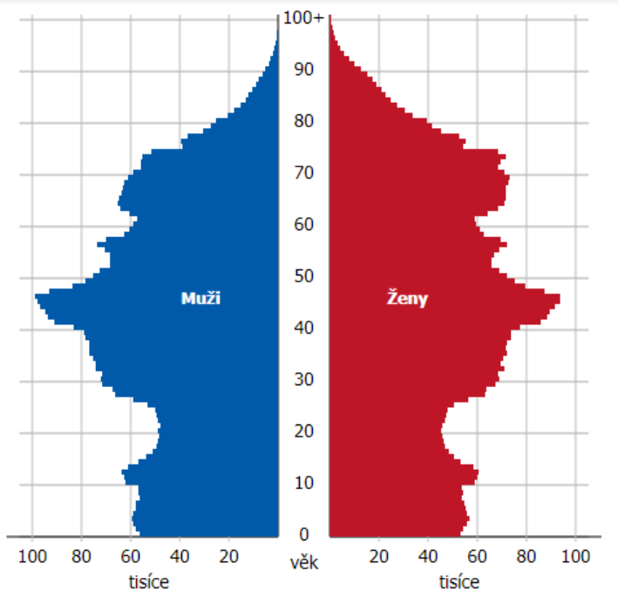
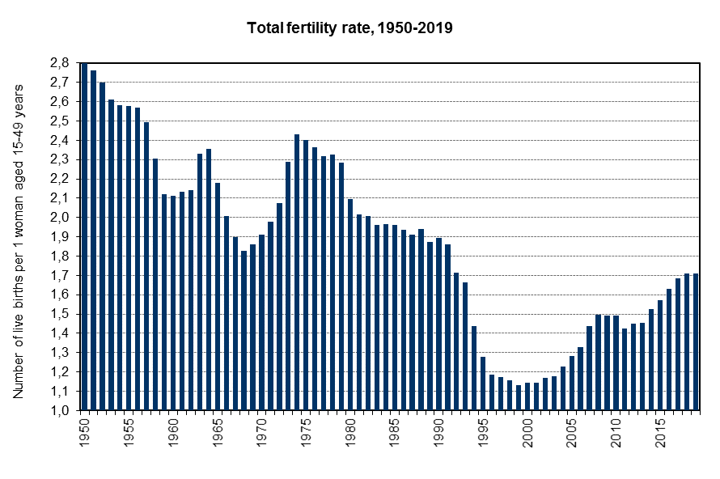
Demographic indicators (I) – drawbacks
Drawbacks examples: Analysing fertility with absolute numbers, sever covid and vaccination thru relative measures, age specific index of abortion
Age structure of Czechia at 1. 1. 2021
Total fertility rate (average number of children per woman), Czechia, 1950–2019

Slide 5
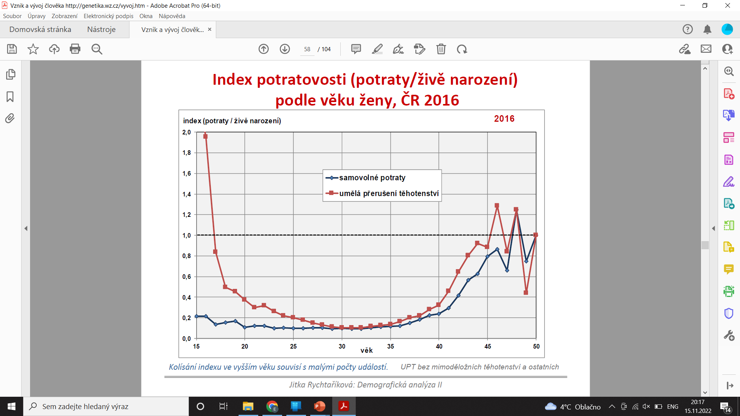
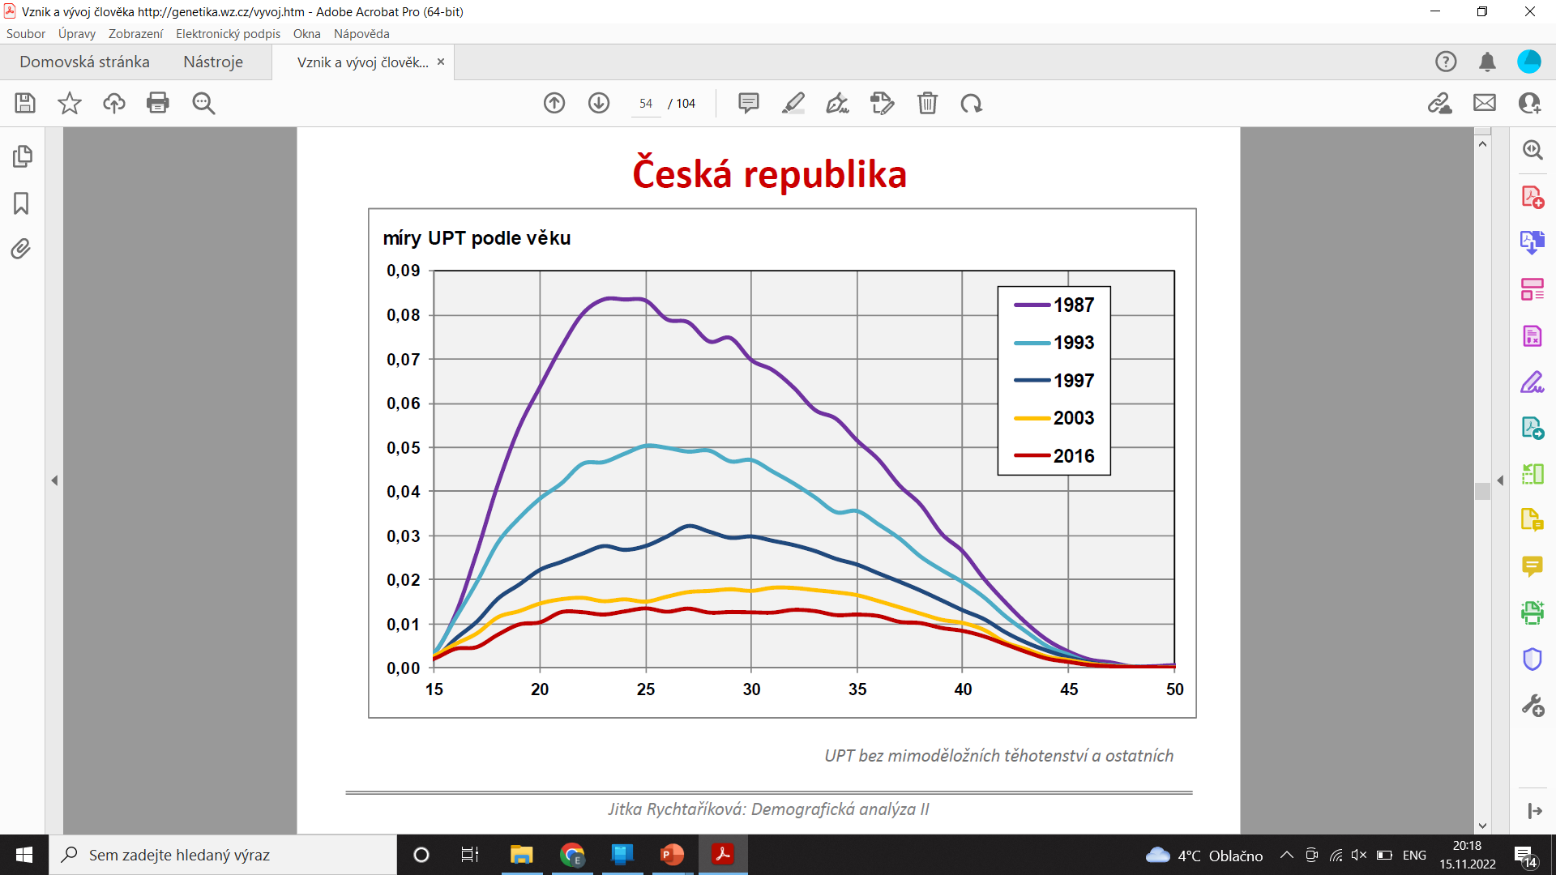
Demographic indicators (I) – drawbacks
Drawbacks examples: Analysing fertility with absolute numbers, sever covid and vaccination thru relative measures, age specific index of abortion
Age specific index of abortion, Czechia, 2016
Age specific abortion rates, Czechia, 2016

Slide 6
Demographic indicators (II)
Crude
Crude death rate, crude birth rate…
General
General fertility rate…
Specific
Age specific death rate…
Differential
Age specific death rates by educational attainment, by parity…
Analytical (synthetic)
Total fertility rate, life expectancy…
Standardized, adjusted, corrected
Standardized death rate…

Slide 7
Demographic indicators (III)
Provisional
Final
Revised
Corrected

Slide 8

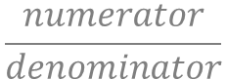
$$\frac{numerator}{denominator}$$
Rates and probabilities
= Two major categories of measures used by demographers
$$rates= \frac{Number of occurences of events}{Exposure}$$
Exposure ~ Average size of a population during a given period ~ Number of person years exposure to risk ~ Mid-year population at risk
$$probabilities= \frac{Number of occurences of events}{Population at risk at the beginning of the interval}$$
$Population at risk at the beginning of the interval$ ~ Population on 1st of January
Age specific mortality rate is denoted as u_{x} or m_{x}. Age specific probability is denoted as q_{x}. From that, these measures are sometimes called m-rates and q-rates, even tough both of them are not rates.
Probabilities are sometimes called „quotients “ [2].
Rates are central death rates.

Slide 9
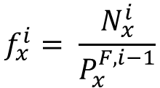
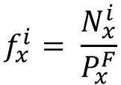
Age specific mortality rates
Events are either evitable (avoidable; birth of a child) or inevitable (unavoidable; death). Events can also be repeatable (birth of a child) or unrepeatable (death). These differences have implication for computations of rates and probabilities.
If the events are avoidable, we distinguish between
Rates of the first type (conditional rates, occurrence-exposure rates)
Rates of the second type (unconditional rates, reduced rates, frequencies)
$$f_{x}^{i}= \frac{N_{x}^{i}}{P_{x}^{F}}$$
Age specific unconditional fertility rate:
i birth order of a child
F female
x age
N number of birth
P population exposure
$$f_{x}^{i}= \frac{N_{x}^{i}}{P_{x}^{F, i−1}}$$
Age specific conditional fertility rate:

Slide 10
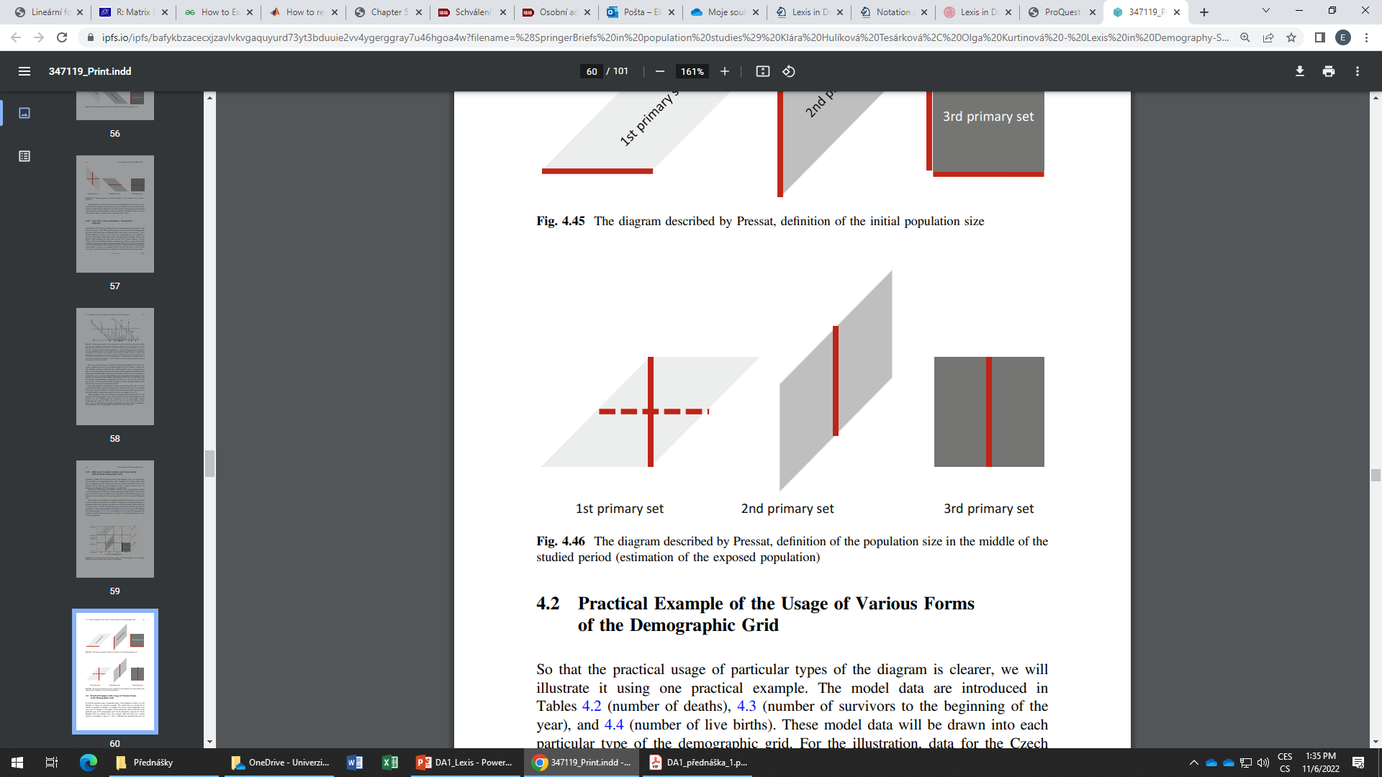
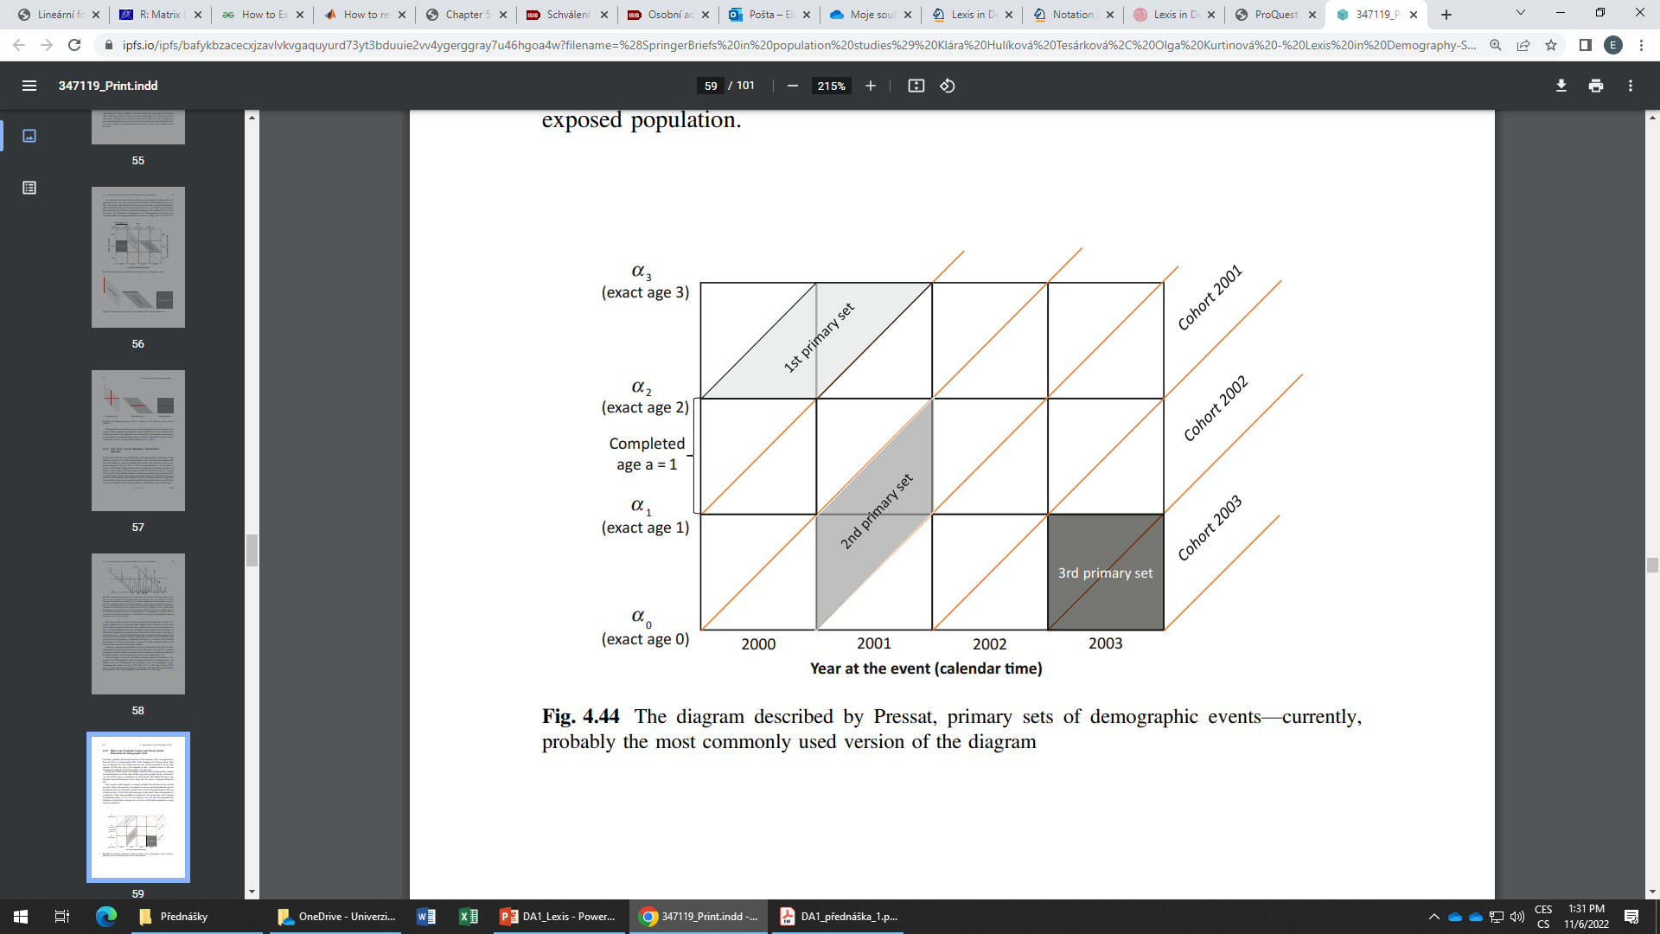
Age specific mortality rates
Mortality rates can also be distinguished according to the sets of events they belong to.
_{t–t+n}m_{x}
To calculate the rates, we need to sum events located in right elementary sets of events and consequently, estimate the population exposure.
1st primary sets
Rates by horizontal
parallelograms
Rates by age
completed and cohort
_{t}m_{x–x+n}
2nd primary sets
Rates by vertical
parallelograms
Rates by age reached
and a cohort
_{t}m_{x}
3rd primary sets
Rates by squares
Rates by age completed
and a year (period)
Source: [3], [4]

Slide 11
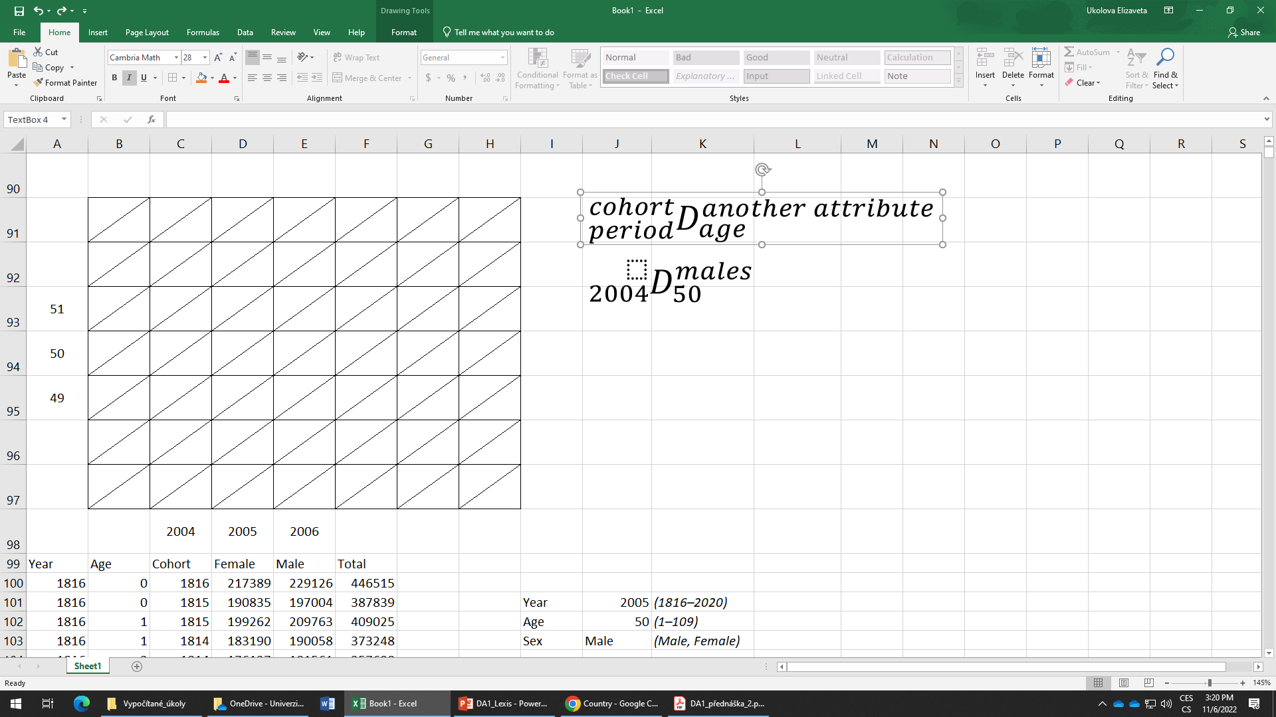
Exercise 2
Estimate a., b., c., d. and e.
22
b.
100
105
e.
21
10 000
10 500
120
115
a.
d.
110
100
20
c.
90
95
2000
2001
2002
2003

Slide 12
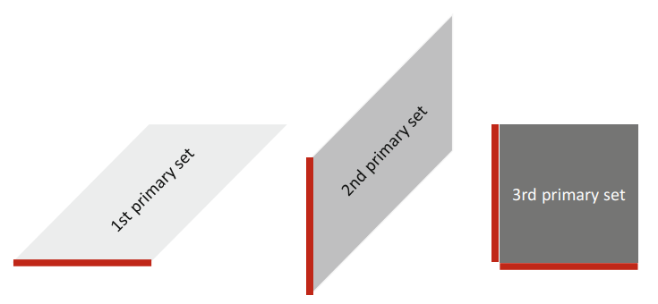
Age specific probabilities of death
Age specific probabilities of death can be computed either directly or indirectly.
The indirect estimation relies on derivation of probabilities from mortality rates.
The direct estimation relies in direct computations from data (dividing events by population at the beginning of the interval, in other words by the initial population).
q_{x}
Indirect method
Linear method
Exponential method
Direct method
Today we will only estimate the probabilities with direct method, however, this does not mean, that this approach is more or less important than the other one.
Initial population size
Source: [3]

Slide 13
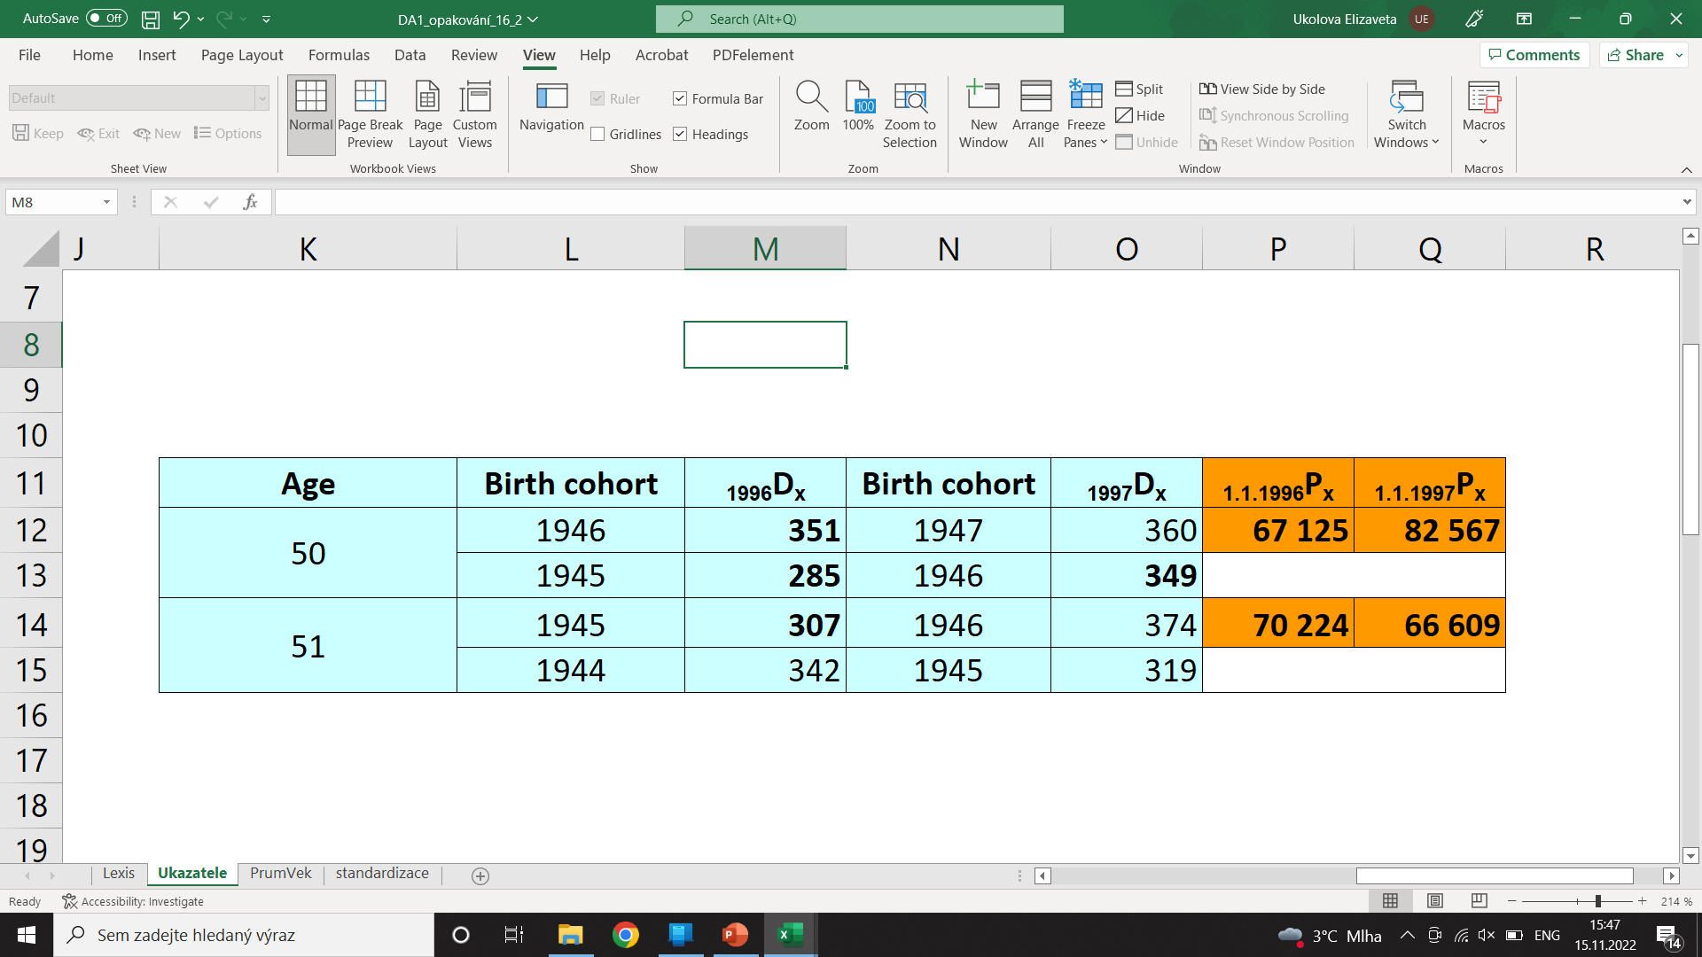
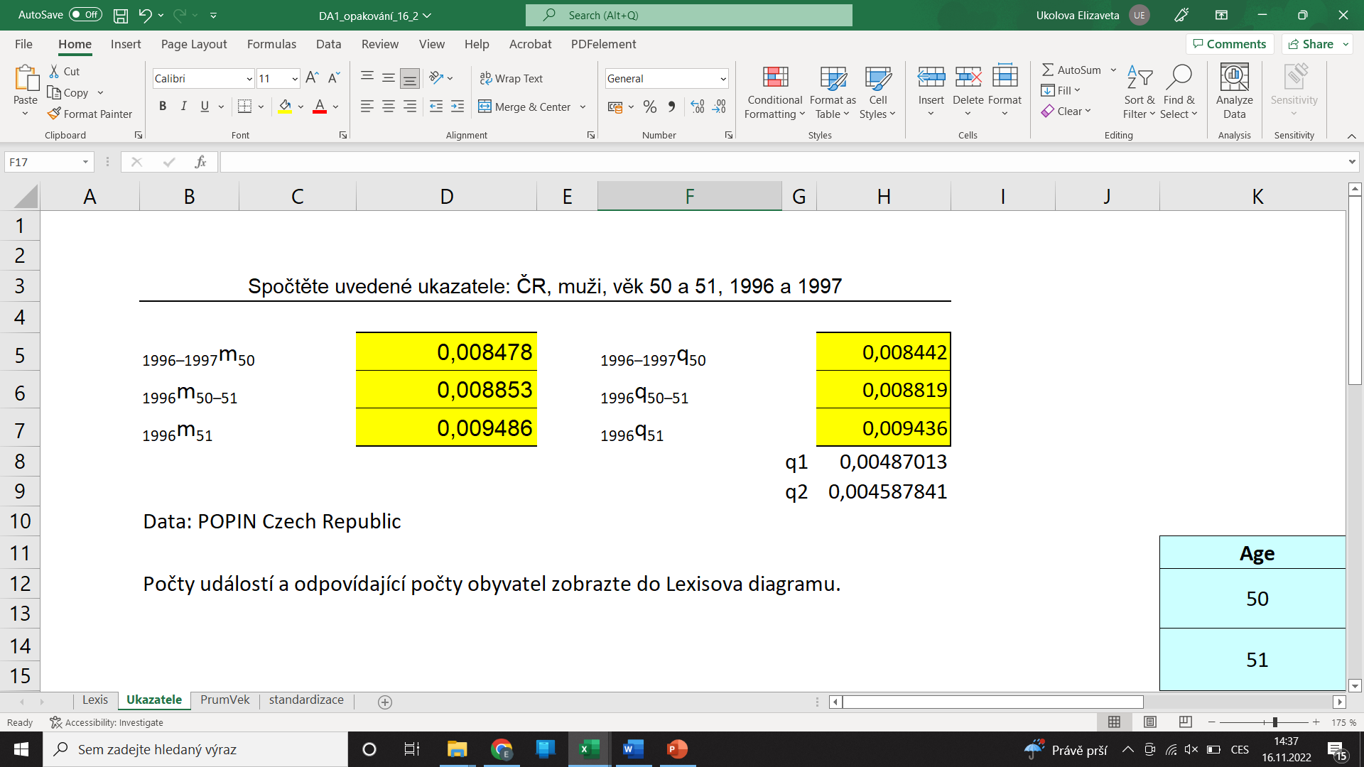
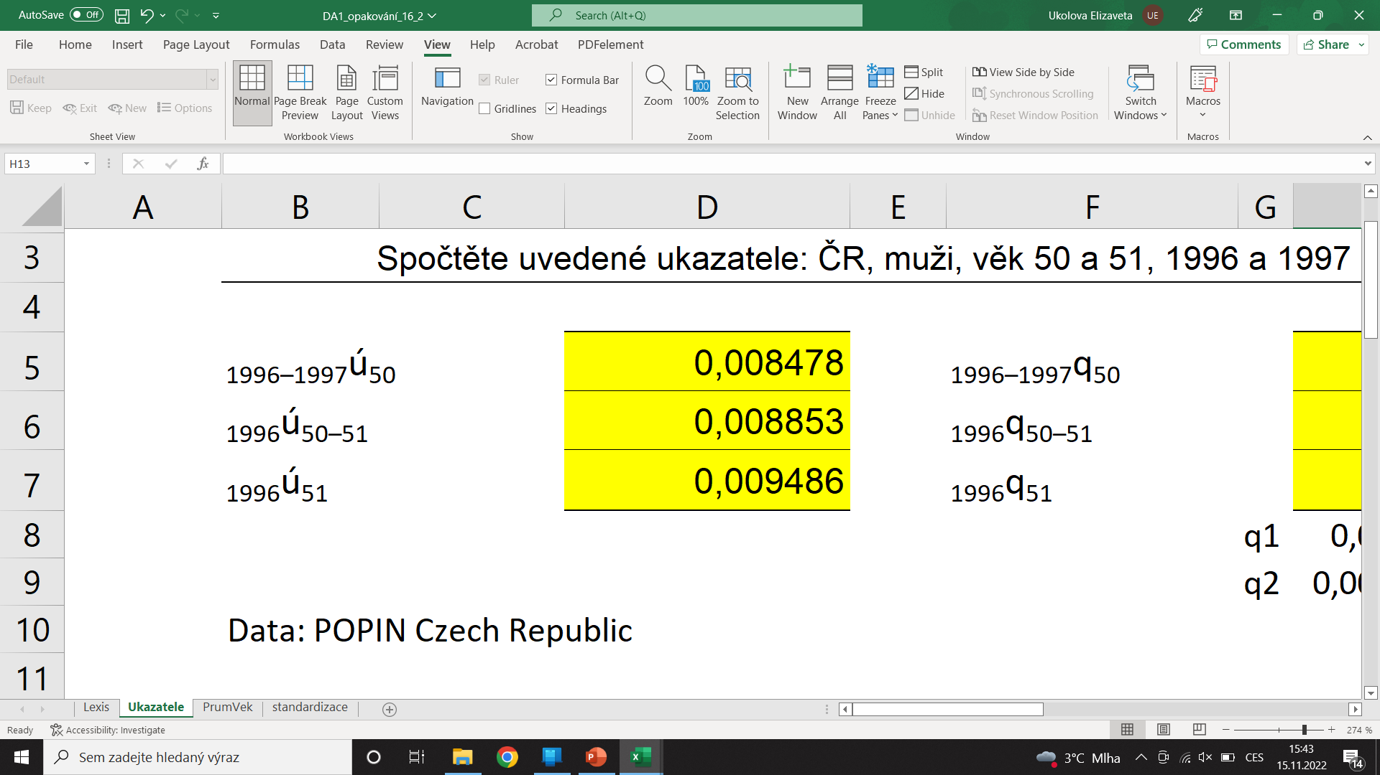
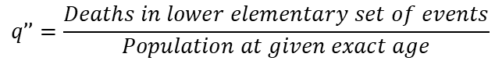
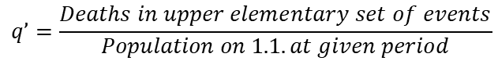


Direct calculation of rates and probabilities: example
Draw following data to Lexis diagram:
$${{}_{period}^{cohort}D}_{age}^{\begin{aligned}another \\ attribute\end{aligned}}$$
Calculate age specific mortality rates a probabilities of dying:
Can be directly estimated from Lexis diagram
Remember (in 3rd sets of events)
$${{}_{t}^{c−(c+1)}q}_{x}=\left(q’+q’’\right)−\left(q’×q’’\right)$$
Can be directly estimated from Lexis diagram and a formulae has to be applied
$$q’=\frac{Deaths in upper elementary set of events}{Population on 1.1. at given period}$$
$$q’’=\frac{Deaths in lower elementary set of events}{Population at given exact age}$$

Slide 14
Direct calculation of rates and probabilities: example
Draw following data to Lexis diagram:
$${{}_{period}^{cohort}D}_{age}^{\begin{aligned}another \\ attribute\end{aligned}}$$
Calculate age specific mortality rates a probabilities of dying:
c 1944
c 1945
52
c 1946
52’
319
342
51
70 224
66 609
c 1947
307
374
51’
349
285
50
67 125
82 567
351
360
50’
49
1996
1997

Slide 15

Direct calculation of rates and probabilities: example
c 1944
c 1945
52
c 1946
52’
342
319
51
70 224
66 609
c 1947
307
374
51’
66 840*
82 218
285
349
50
67 125
82 567
351
360
50’
82 918
49
1996
1997
$${{}_{period}^{cohort}D}_{age}^{\begin{aligned}another \\ attribute\end{aligned}}$$
66 916*

Slide 16
Direct calculation of rates and probabilities: example
c 1944
c 1945
52
c 1946
52’
342
319
51
70 224
66 609
c 1947
307
374
51’
66 840*
82 218
285
349
50
67 125
82 567
351
360
50’
82 918
49
1996
1997
$${{}_{period}^{cohort}D}_{age}^{\begin{aligned}another \\ attribute\end{aligned}}$$
66 916*

Slide 17
Direct calculation of rates and probabilities: example
c 1944
c 1945
52
c 1946
52’
342
319
51
70 224
66 609
c 1947
307
374
51’
66 840*
82 218
285
349
50
67 125
82 567
351
360
50’
82 918
49
1996
1997
$${{}_{period}^{cohort}D}_{age}^{\begin{aligned}another \\ attribute\end{aligned}}$$
66 916*

Slide 18
Direct calculation of rates and probabilities: example
c 1944
c 1945
52
c 1946
52’
342
319
51
70 224
66 609
c 1947
307
374
51’
66 840*
82 218
285
349
50
67 125
82 567
351
360
50’
82 918
49
1996
1997
$${{}_{period}^{cohort}D}_{age}^{\begin{aligned}another \\ attribute\end{aligned}}$$
66 916*

Slide 19
Rates and probabilities: remarks
Rates are not dependant upon the length of intervals, whereas probabilities are.
We assume that those, who undergo competing events, have same mortality as those, who do not undergo competing events (f. e. migration)
We assume uniform distribution of deaths over the time and age.
 |  | Age
 |  | 50 |  | 50–54
 |  | m_{x} | q_{x} | m_{x} | q_{x}
Period | 2015 | 0,002140 | 0,002140 | 0,002484 | 0,012360
 | 2015–2019 | 0,002032 | 0,002030 | 0,002390 | 0,011880
Source: [5]

Slide 20
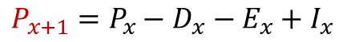
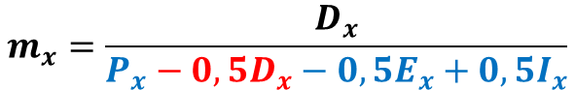
Rates and probabilities: remarks
We assume uniform distribution of deaths over the time and age.
$$P_{x+1}=P_{x}−D_{x}−E_{x}+I_{x}$$
$$0,5\left(P_{x}+P_{x+1}\right)=0,5\left(P_{x}+P_{x}−D_{x}−E_{x}+I_{x}\right)=P_{x}−0,5D_{x}−0,5E_{x}+0,5I_{x}$$
$$m_{x}=\frac{D_{x}}{P_{x}−0,5D_{x}−0,5E_{x}+0,5I_{x}}$$
–0,5D_{x} → average contribution to exposure of those who died in given one year age interval was 0,5, which is the implication of uniformity assumption
In certain age groups, the assumption of uniform distribution od deaths over an age intrval does not hold (f. e. age 0, very high ages). Therefore, at these ages we consider non-uniformity by using adjusted formulas or different methods to estimate the intensity of mortality.
Source: [2]

Slide 21
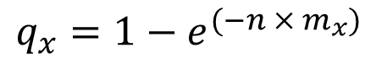
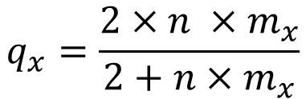
Indirect estimation of age specific probabilities of death
q_{x}
Indirect method
Linear method
Exponential method
Direct method
$$q_{x}=\frac{2×{n ×m}_{x}}{2+n×m_{x}}$$
Linear method:
Exponential method:
$$q_{x}=1−e^{(−n × m_{x})}$$
These two methods are based on different assumptions about the shape of survival curve over an age interval (x, x+n]. The expression for linear method assumes that l_{x} (survivors at age x) is a straight line over a single age interval (x, x+n]. The expression for exponential method assumes, that l_{x} is an exponential curve over an age interval (x, x+n).
Source: [6]

Slide 22
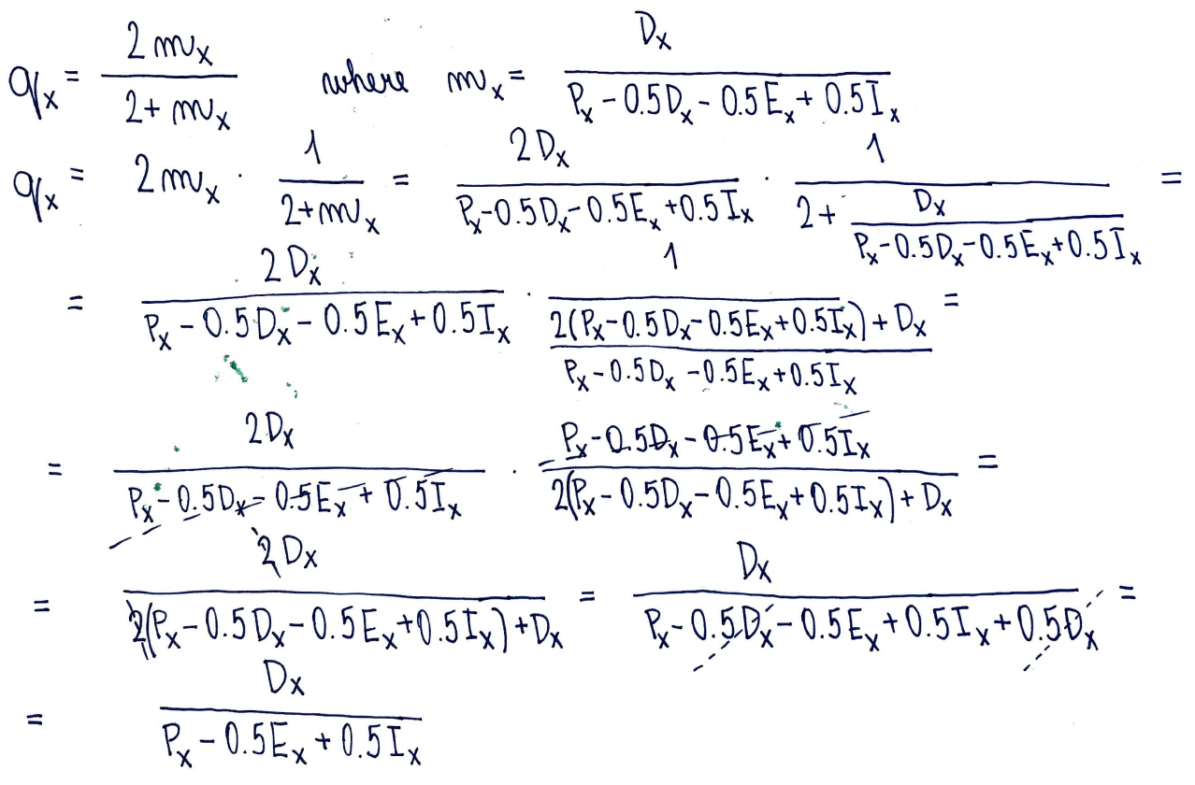
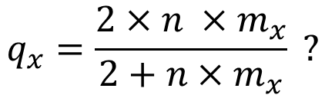
Indirect estimation of age specific probabilities of death
What is behind the formula
$$q_{x}=\frac{2×{n ×m}_{x}}{2+n×m_{x}} ?$$
The difference between m_{x} and q_{x} lies in denominator (–0,5D_{x}). The presence of “–0,5Dx” in denominator of the fraction implies, that for age group (x, x+n] mortality rates shall be higher than probabilities of death (exception: age 0, extremely high ages).
For n = 1:
Migration ~ Competing event, assuming no migration, the net probability equals to Deaths/Population at the beginning of the interval
Net probability of dying (Berkson)

Slide 23
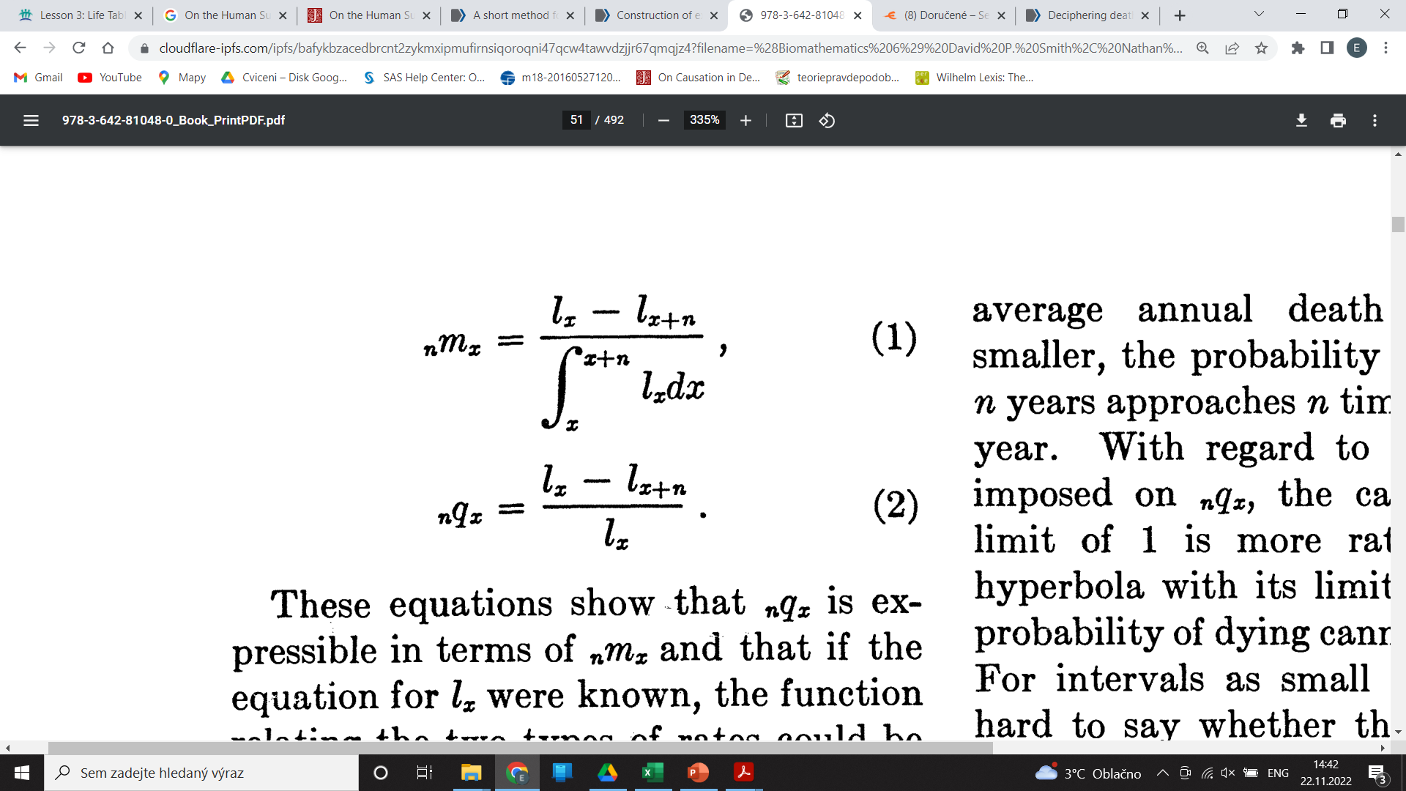
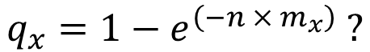
Indirect estimation of age specific probabilities of death
What is behind the formula
$$q_{x}=1−e^{\left(−n × m_{x}\right)} ?$$
Relationship between q_{x} and m_{x} can be expressed thru other life table functions. Most directly thru l_{x} (number of persons left alive at exact age x). It applies:
The difference between persons at exact ages x and x+n equals to number of deaths (in model, closed population, like LT)
We consider l_{x} is a discrete function. Integrating discrete functions can be understood as ∑ the elements within bounds, in this case (x, x+n]. We divide deaths by sum of persons in exacts ages in interval (x, x+n], which is our exposure.
Numerator is same as above. The deaths are divided by persons in exact age x (beginning of the interval).
So far, everything comes back to the very basic definition of rates and probabilities.
Source: [7]

Slide 24
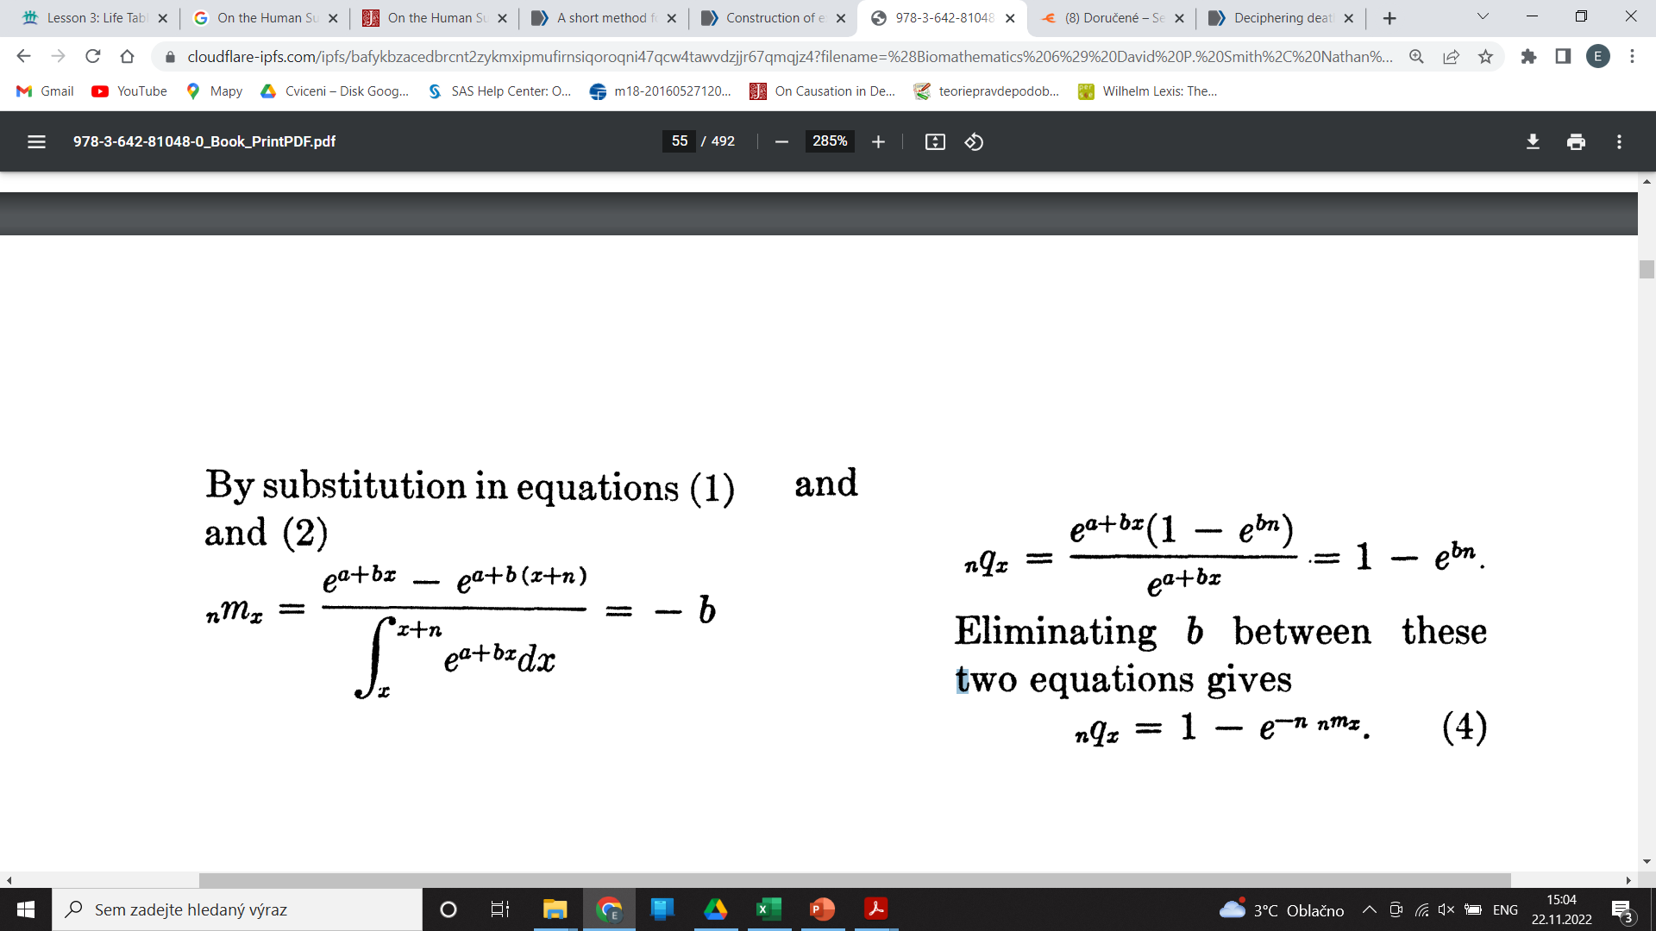
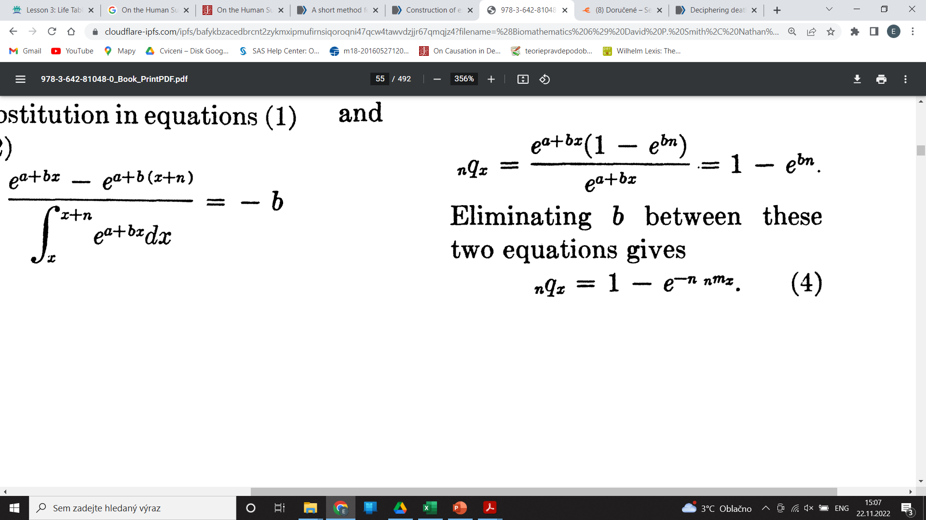
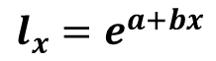
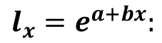
Indirect estimation of age specific probabilities of death
What is behind the formula
$$q_{x}=1−e^{\left(−n × m_{x}\right)} ?$$
By the Gompertz law of mortality, it applies:
$$l_{x}=e^{a+bx}$$
Substitute formulas below with
$$l_{x}=e^{a+bx}:$$
Get this:
In formula for q_{x} put m_{x} instead of b:
Source: [7]

Slide 25
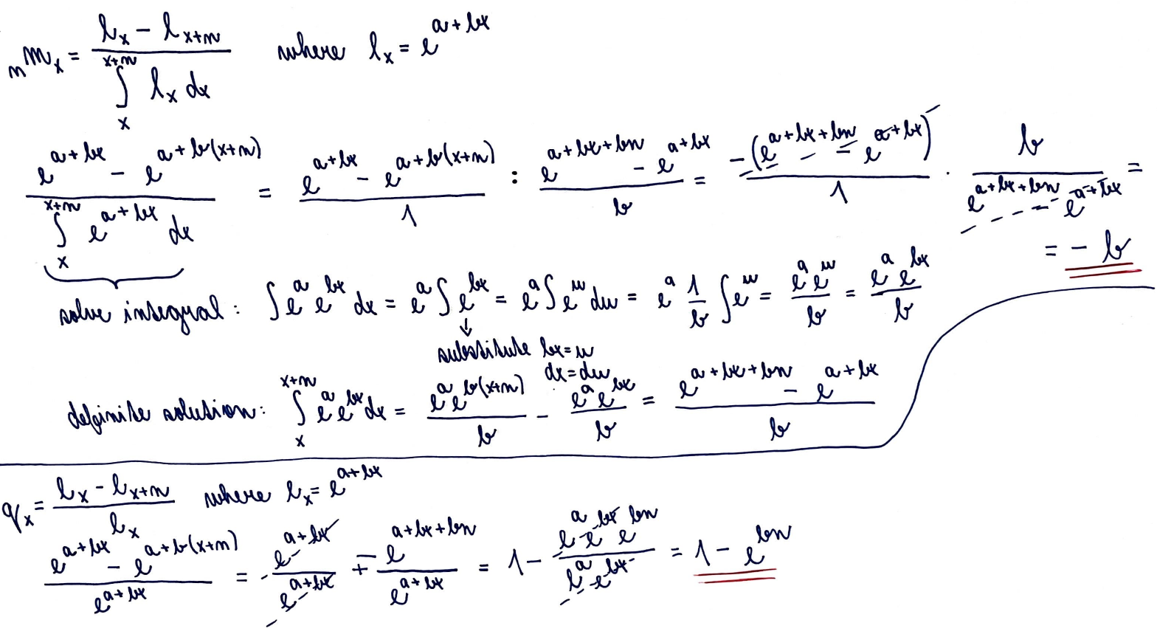
Indirect estimation of age specific probabilities of death

Slide 26
Indirect calculation of probabilities: example
Calculate age specific probabilities of death for French females in 2015, single ages. Apply linear as well as exponential method. Plot the results. Discuss the differences in estimated rates and probabilities and general shape of „mortality curves“.
Data source: Human Mortality Database (Registration is needed)

Slide 27
Sources
[0] Slides provided by dr. Burcin
[2] CASELLI, Graziella; VALLIN, Jacques; WUNSCH, Guillaume. Demography: Analysis and Synthesis, Four Volume Set: A Treatise in Population. Elsevier, 2005. Part II, Chapter 8. Pages 79–86.
[3] TESÁRKOVÁ, Klára Hulíková; KURTINOVÁ, Olga. Lexis in Demography. Springer International Publishing, 2018. Pages 11–14 & 46–48. Available online per CKIS.
[4] Methods protocol of Human Mortality Database. University of California, Berkeley (USA), and Max Planck Institute for Demographic Research (Germany). Available online: https://www.mortality.org/File/GetDocument/Public/Docs/MethodsProtocolV6.pdf.
[5] SWANSON D. A., SIEGEL J. S. The methods and materials of demography. Elsevier. San Diego. 2004. ISBN: 0-12-641955-8. Available online per CKIS or at https://demographybook.weebly.com/uploads/2/7/2/5/27251849/david_a._swanson_jacob_s._siegel_the_methods_and_materials_of_demography_second_edition__2004.pdf. Pages 265–340.
[6] Fergany, N. (1971). On the Human Survivorship Function and Life Table Construction. Demography, 8(3), 331–334. https://doi.org/10.2307/2060621. Available online: https://www.jstor.org/stable/pdf/2060621.pdf?refreqid=excelsior%3Ada90c51056d89db94ef8d79f5eaf46fd&ab_segments=&origin=.
[7] Reed LJ, Merrell M. A short method for constructing an abridged life table. 1939. Am J Epidemiol. 1995 Jun 1;141(11):993-1022; discussion 991-2. doi: 10.1007/978-3-642-81046-6_7. PMID: 7771448.

